Slide 1



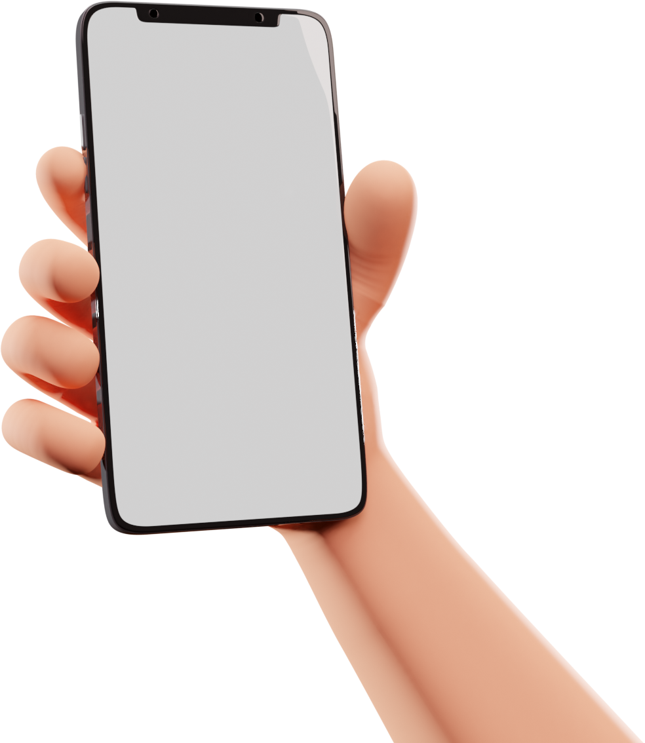

CHAT APPLICATION
Merry Christmas
& A Happy New Year!
from the Johnsons
PRESENTATION

Slide 2
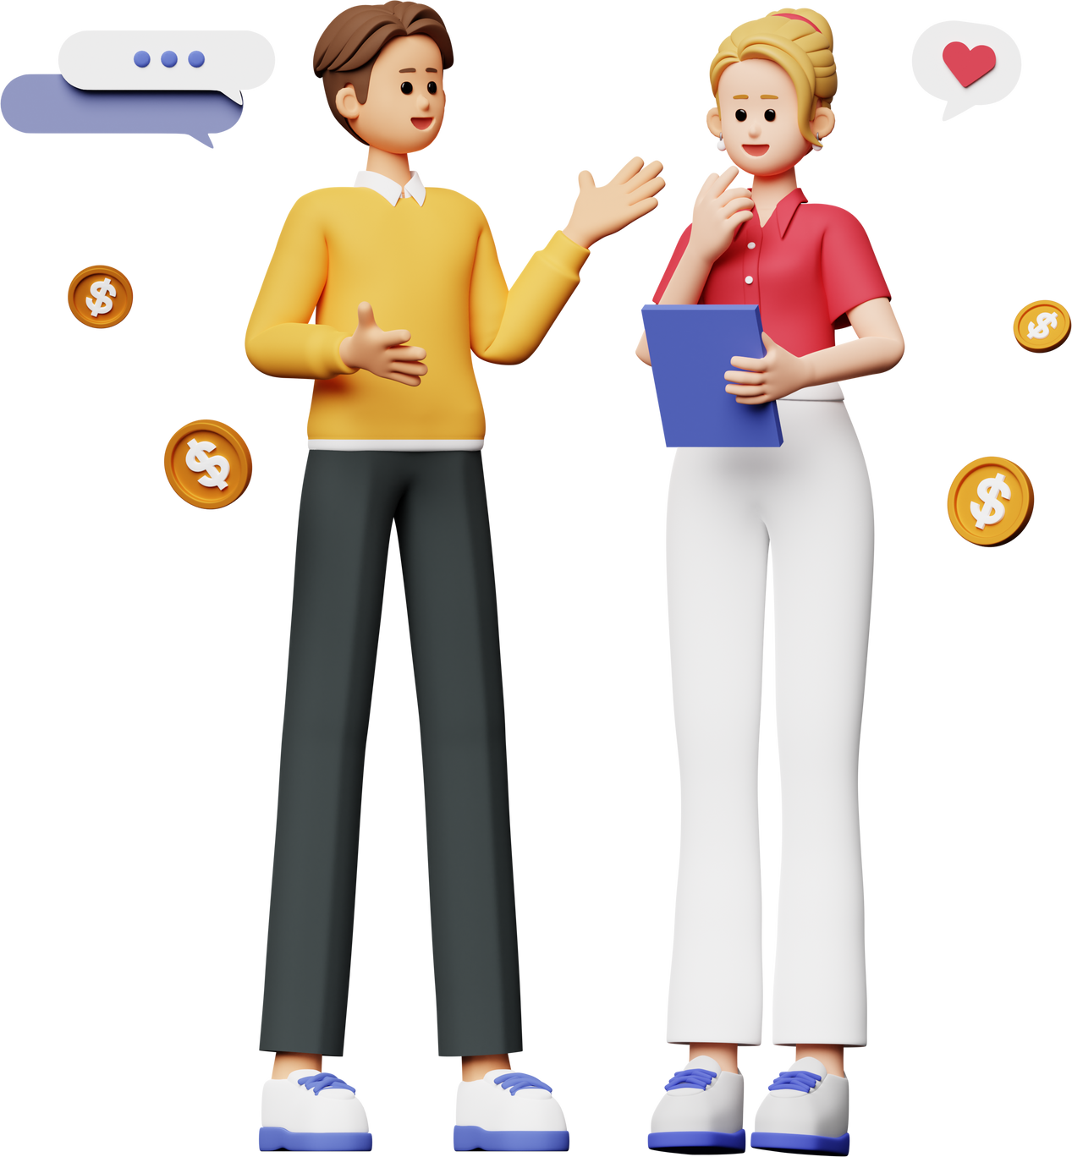


TEAM
MEMBER
Supervisor:- Ms. Shweta Singh
SHUBHANSHU Mohan 2300290140180,
Sumit Singh 2300290140187,
Vishal Yadav 2300290140206

Slide 3



INTRODUCTION
The Chat Application is a real-time platform built using the MERN stack, facilitating instant messaging between users. It utilizes MongoDB for data storage, Express.js for backend development, React.js for frontend interface, and Node.js for server-side operations, enabling seamless communication and interaction in real-time.

Slide 4
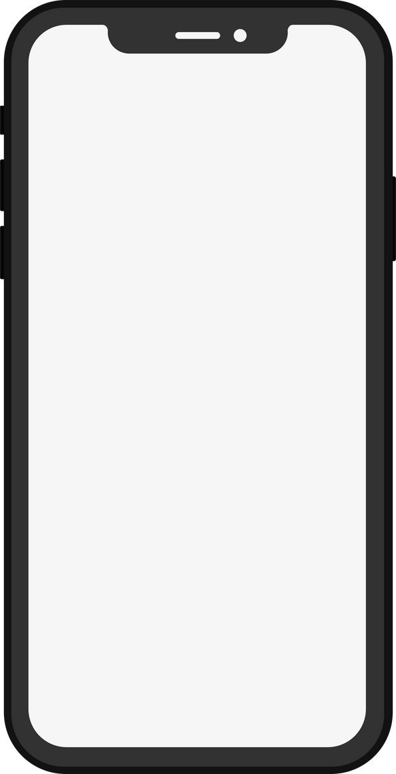

Literature Review
Evolution of chat applications
Growth of real-time communication technologies
Importance of WebSocket's and real-time messaging
Existing solutions like WhatsApp, Messenger
Challenges faced: Scalability, Security, Speed

Slide 5


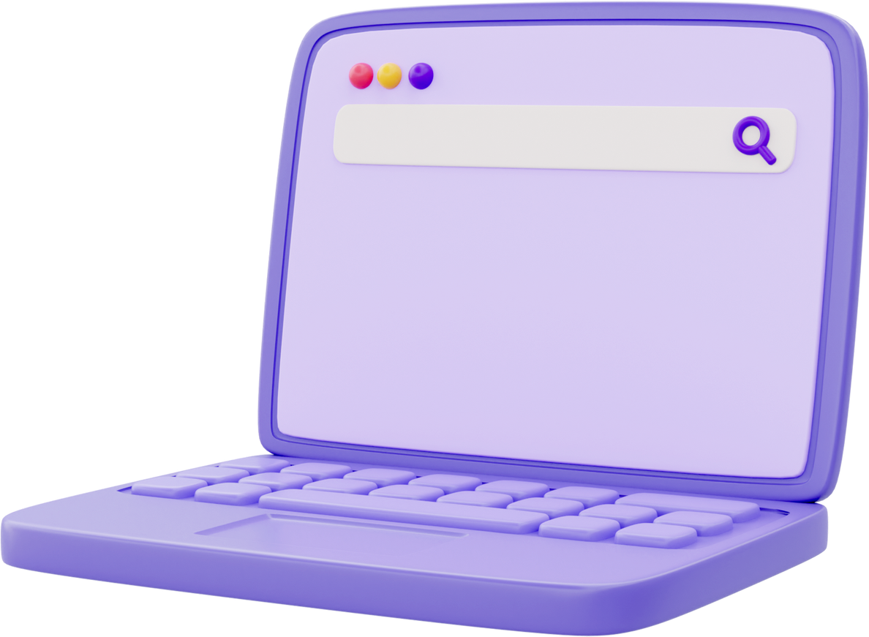
TECHNOLOGIES
AND SOFTWARE REQUIREMENT
Technologies
MongoDB
Express.js
React.js
Node.js
WebSocket Protocol
Socket.IO

Slide 6

HARDWARE
REQUIREMENT
Processor: Intel Core / AMD RYZEN or equivalent
RAM: Minimum 8GB
Storage: 256 GB SSD
Network Interface: Gigabit Ethernet
/user

Slide 7
Module
User Authentication (Signup/Login, JWT-based security)
Chat Module (One-to-one and group messaging)
Notification Module (Real-time alerts, message status)
Database Module(User Data Storage, Message History Storage)

Slide 8
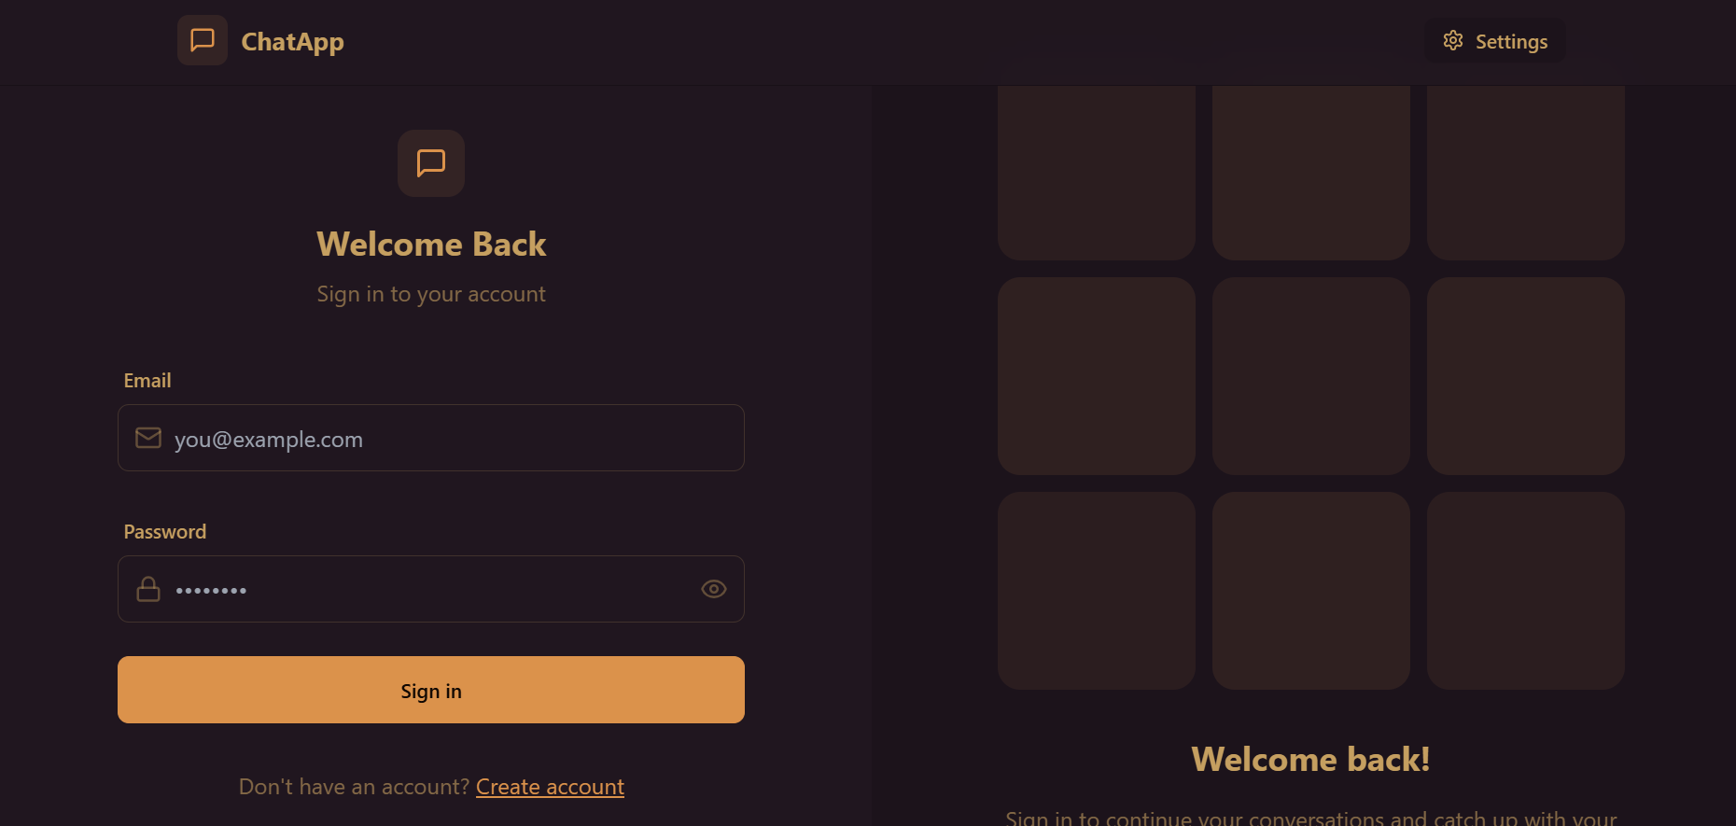
Login

Slide 9
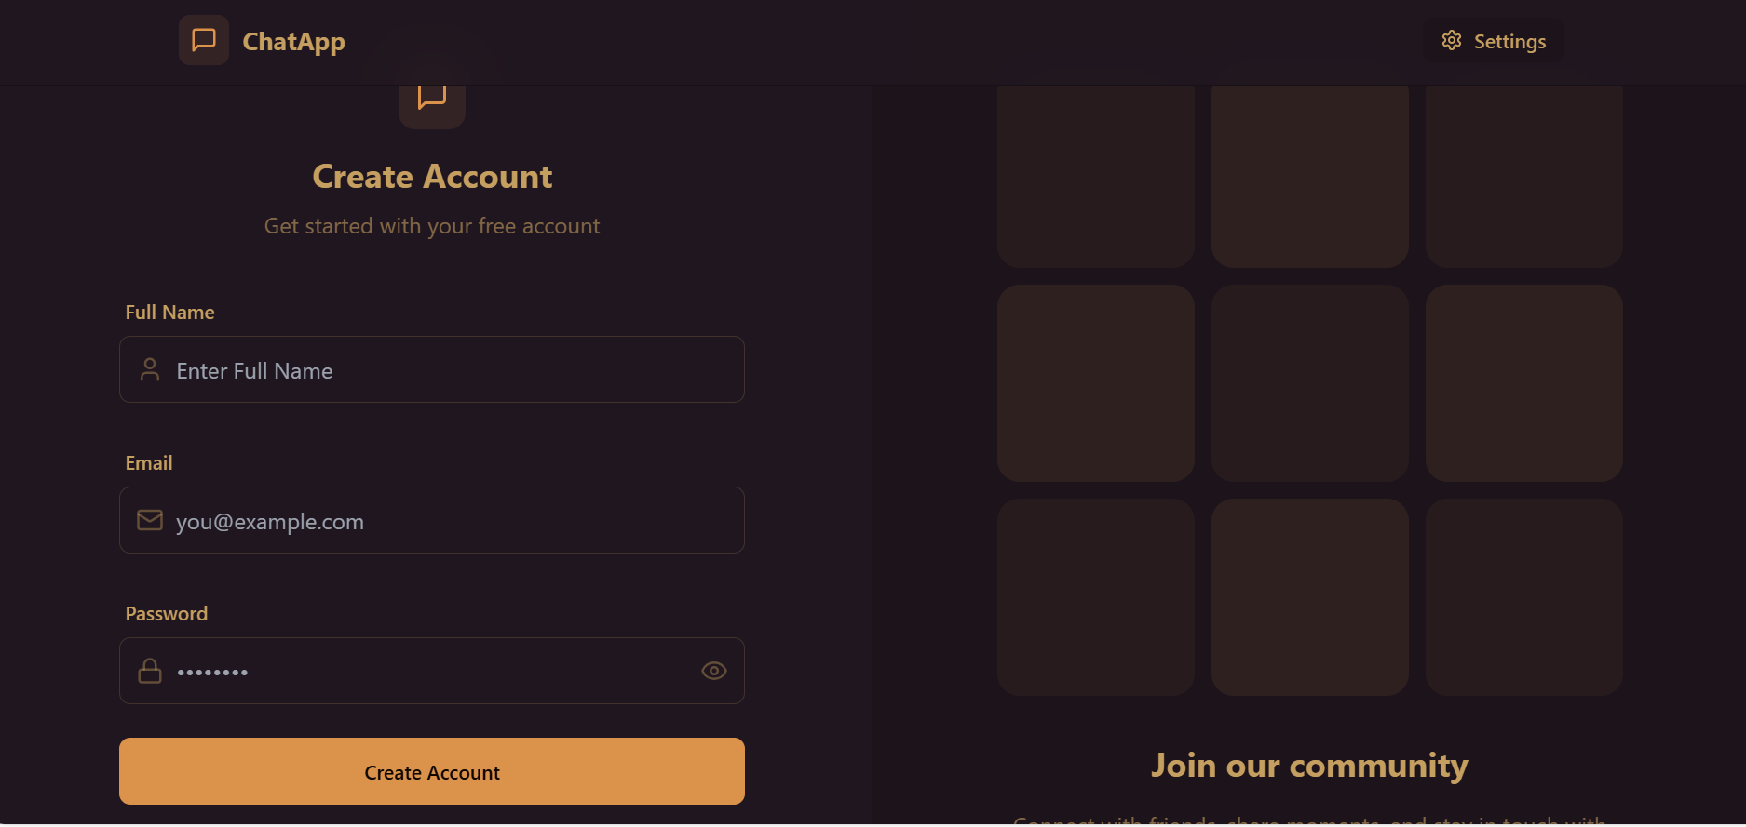
Sign up

Slide 10
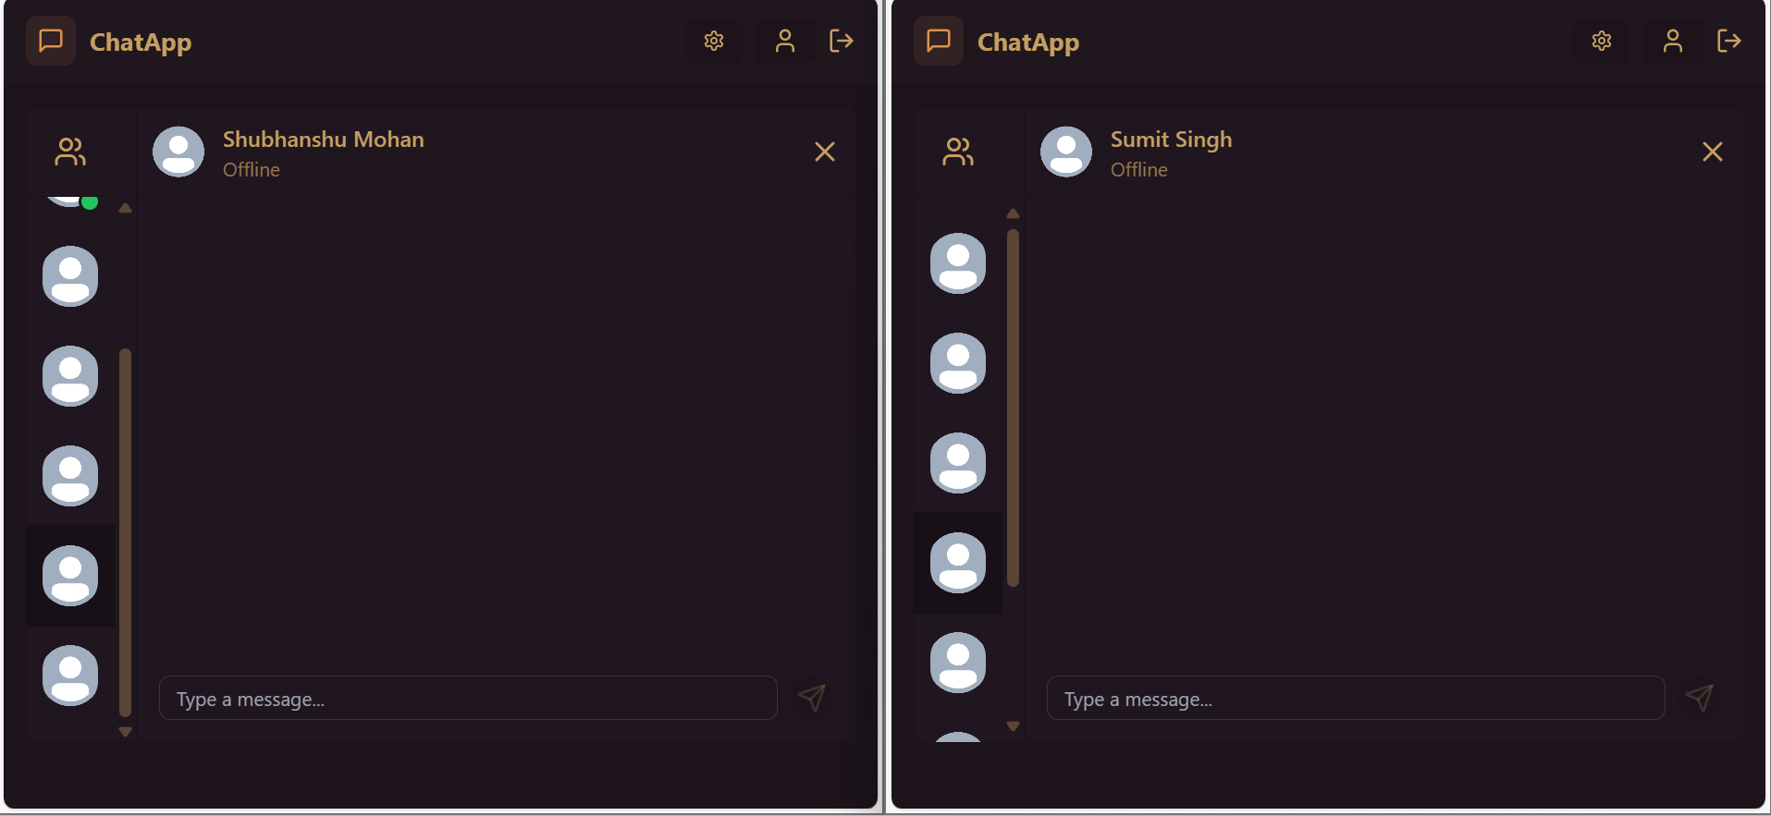
Chat Window

Slide 11
Workflow
User registers/login
Connects to socket server
Sends/receives messages in real-time
Data stored in MongoDB
Notifications and read receipts sent

Slide 12
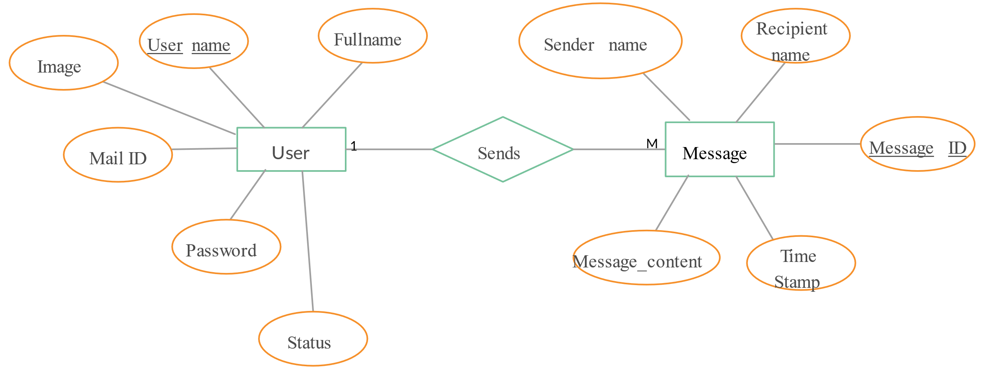
ER Diagram

Slide 13
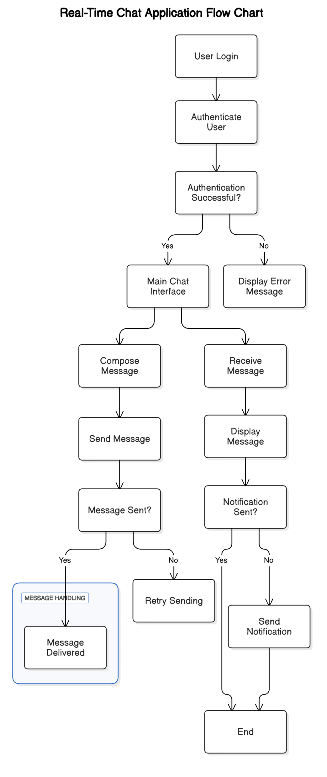
DFD

Slide 14
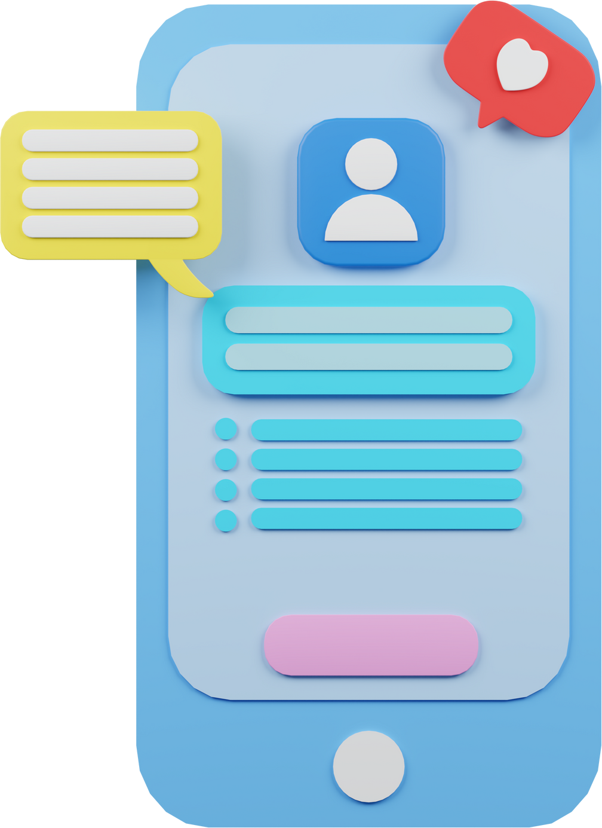

REPORTS / OUTPUTS
Presentation of data or findings
Generated documents or files
Visual representations such as charts or graphs
Automated reports
Data exports in various formats
Alerts or notifications

Slide 15
GANTT CHART
Product Launch Plan
Week 1
Week 2
Week 3
Week 4
Week 5
Week 6
Requirement Analysis
Feasibility Study
Coding
Testing
Presentiation
Deployment

Slide 16
THANK YOU..!!

